Slide 1
第十五章
变速器与分动器
Chapter 15
Transmission and Transfer Case

Slide 2
主要内容 Main contents
变速器的组成、功用和类型；
Components of transmission, Functions, Types;
变速器的变速传动机构；
Speed-change driving mechanism;
同步器；
Synchronizer;
变速器的操纵；
Shifting operation mechanism;
分动器。Transfer case.

Slide 3
变速器的组成、功用与分类
Components of transmission, Function of transmission, Classification;
变速器的组成
Components of transmission
变速器由变速传动机构和操纵机构组成。
Transmission is composed of speed-change driving mechanism and shifting operation mechanism.

Slide 4
变速器的功用 Function of transmission
改变传动比，扩大驱动轮的转矩和转速的范围，以适应经常变化的行驶工况，使发动机工作在高效区。
It’s used to change gear ratio and expand the range of torque and rotating speed of driving wheels to adapt to working condition and make the engine work in high efficiency area.
实现倒车；
Achieve the function of reverse running;
利用空档，中断动力传递，以使发动机能够起动、怠速，并便于变速器换挡或进行动力输出。
The use of neutral gear can interrupt power delivery, so that the engine can start, idle and the transmission easy to shift gear or to output power.

Slide 5
变速器的分类 Classification
按传动比的变化范围
Sorted by the range of ratio:
有级式变速器 Gear wheel type
无级式变速器Continuously variable transmission
综合式变速器Hydraulic-mechanical type gear box
应用最广泛，由若干个固定的传动比。可分为轴线固定式、轴线旋转式（行星齿轮）。变速器的档位指前进档的数目。The most widely used type. It has several fixed ratios and can be sorted as fixed axis type and rotary axis type. The number of transmission is the number of forward gears.
传动比在一定的范围内可以连续变化。可分为电力式、液力式（动液式）。Gear ratio can be continually changed in a certain range and sorted as electric and hydraulic type.
液力变矩器和齿轮式有级变速器组成的液力机械变速器。传动比可在几个间断内连续变化。It’s formed by a hydrodynamic converter and a gear wheel type transmission. The gear ratio can be continually changed in several separated areas.

Slide 6
变速器的分类 Classification
按操纵方式
Sorted by maneuverability pattern:
强制操纵式
Manual operating type
自动操纵式
Automatic operating type
半自动操纵式
Semi-Automatic operating type
驾驶员直接操纵变速杆换档。The driver directly manipulates the gear lever to shift gear.
换档与传动比的选择是自动进行的。Gear shifting and ratio selection is automatically operated.
固定式：几个常用的档位自动，其余由驾驶员操纵。Fixed type: several commonly used gears are automatically shifted and the others manipulated by the driver.
预选式：先选取档位，换档过程自动。Preselector type: select the gear first and automatically shift gear.

Slide 7
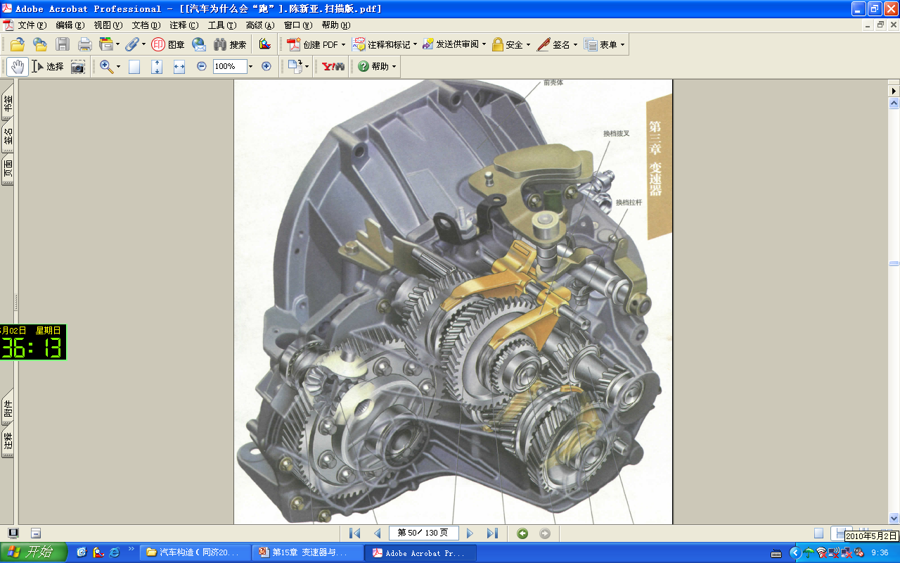
第一节 变速器的变速传动机构
Section 1 Speed-change driving mechanism

Slide 8
变速传动机构分类
Classification of speed-change driving mechanism
普通齿轮式变速器 General gear box
一般将轴线固定的有级变速器称为普通齿轮式变速器。 Fixed axis gear box is normally called normal gear box.
组合式变速器 Combined transmission
以1~2种变速器为主体，通过更换齿轮副或者配备不同的副变速器，得到一组不同档数不同传动比范围的变速器系列。 It’s main component is one or two transmissions, and uses different gear pairs or splitters(sub-transmissions) to achieve a serial of transmissions of different number of speeds and different range of gear ratio.

Slide 9
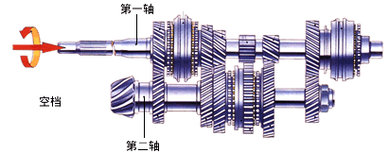
普通齿轮式变速器的分类
Classification of speed-change driving mechanism
按固定齿轮的轴类型：三轴和两轴两种类型（不包括倒档轴）Sorted by the number of fix axis type: twin-shaft transmission and three-shaft transmission
两轴变速器 Twin-shaft transmission
有二种类型的轴：输入轴（第一轴）、输出轴（第二轴）Two kinds of axes: input shaft (clutch shaft), output shaft(main shaft)
动力传递路径 Power drive path
输入轴——输入轴齿轮——输出轴齿轮——输出轴 Input shaft—— Gear of input shaft——Gear of output shaft——Output shaft

Slide 10
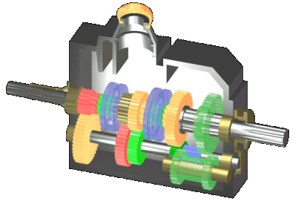
三轴变速器 Three-shaft transmission
有三种类型的轴：输入轴（第一轴）、中间轴、输出轴（第二轴）
Three kinds of shaft : input shaft (clutch shaft), counter shaft, output shaft(main shaft)
动力传递路径 Power drive path
输入轴——输入轴齿轮——中间轴齿轮——输出轴齿轮——输出轴Input shaft—— Gear of input shaft——Gear of counter shaft——Gear of output shaft——Output shaft

Slide 11
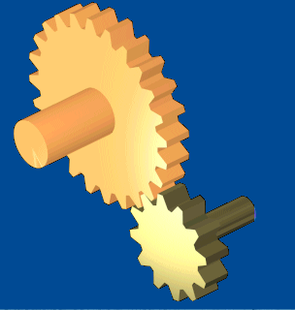
变速器的传动比 Gear ratio
主动轮1 Driving gear 1
=
从动齿轮齿数
i
主动齿轮齿数
Teeth number of driven gear
i
=
Teeth number of driving gear
从动轮2 Driven gear 2

Slide 12
三轴五速变速器传动机构 Speed-change driving mechanism of three shaft five-speed transmission
变速器壳Transmission housing
结合套Hub sleeve
输出轴Output shaft
输入轴Input shaft
变速齿轮Gear
中间轴 counter shaft
倒档轴Reverse shaft

Slide 13
三轴五速变速器传动示意图
Diagram of Speed-change driving mechanism of three shaft five-speed transmission
第一轴前端支撑在发动机曲轴凸缘的滑套中，后端支撑在变速箱前壳体的轴承孔中 The front part of the input shaft is supported by the stud of flange of crankshaft of the engine and the rear by the deadeye of the front transmission housing.
第二轴前端用滚针轴承支撑在第一轴齿轮内孔中，后端支撑在变速箱后壳体的轴承孔中 The front part of the second axis is supported by gear hole of the first axis through a needle bearing and the rear by the deadeye of the rear transmission housing.

Slide 14
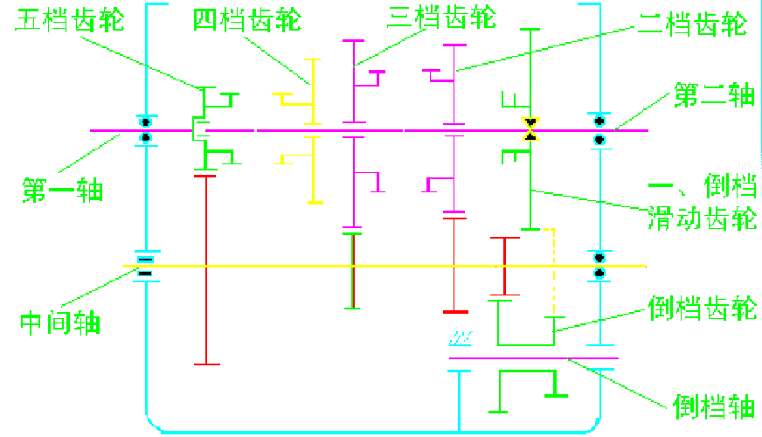
三轴五速变速器传动示意图
Diagram of Speed-change driving mechanism of three shaft five-speed transmission
中心孔Center bore
滚子轴承Rolling bearing
滚子轴承Rolling bearing
滚子轴承Rolling bearing
滚子轴承Rolling bearing
二轴支承Supporting

Slide 15
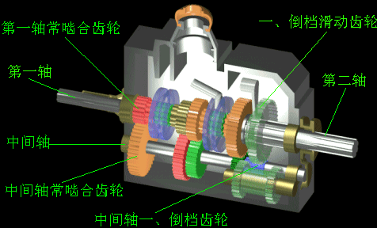
一档换档过程 First gear

Slide 16
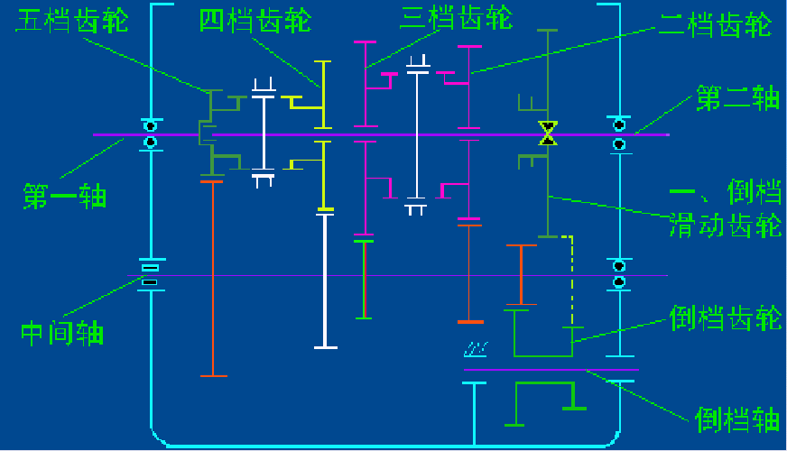
一档传动路线及传动比
Power drive path and gear ratio of first gear
Z₃
Z₁
Z₄
Z₂
Z₅
×
×
Z₁₀
×
×
Z₉
Z₈
Z₇
Z₆
Z₁₂
Z₁₁
此时其它档位齿轮作何运动？
思考

Slide 17
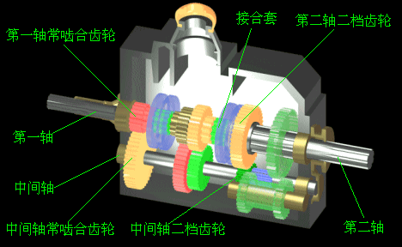
二档换档过程 Second gear

Slide 18
二档传动路线及传动比
Power drive path and gear ratio of second gear
Z₃
Z₁
Z₄
Z₂
Z₅
×
×
Z₁₀
×
×
Z₉
Z₈
Z₇
Z₆
Z₁₂
Z₁₁

Slide 19
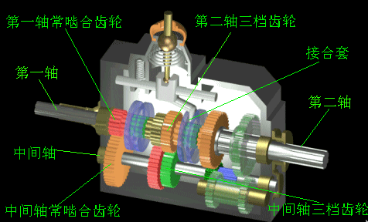
三档换档过程 Third gear

Slide 20
三档传动路线及传动比
Power drive path and gear ratio of third gear
Z₃
Z₁
Z₄
Z₂
Z₅
×
×
Z₁₀
×
×
Z₉
Z₈
Z₇
Z₆
Z₁₂
Z₁₁

Slide 21
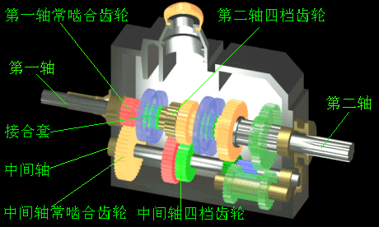
四档换档过程 Forth gear

Slide 22
四档传动路线及传动比
Power drive path and gear ratio of forth gear
Z₃
Z₁
Z₄
Z₂
Z₅
×
×
Z₁₀
×
×
Z₉
Z₈
Z₇
Z₆
Z₁₂
Z₁₁

Slide 23
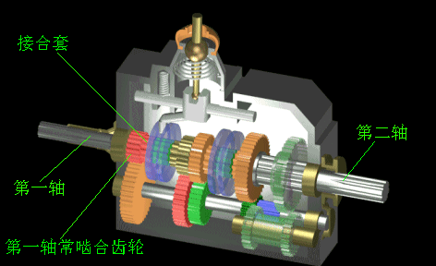
五档换档过程 Fifth gear

Slide 24
五档传动路线及传动比
Power drive path and gear ratio of fifth gear
Z₃
Z₁
Z₄
Z₂
Z₅
×
×
Z₁₀
Z₉
Z₈
Z₇
Z₆
Z₁₂
Z₁₁

Slide 25
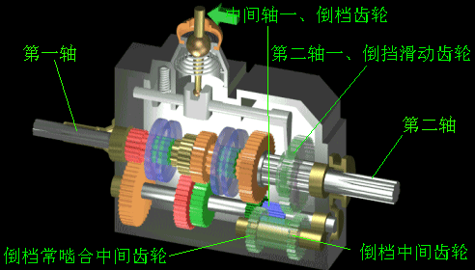
倒档换档过程Back-up gear

Slide 26
倒档传动路线及传动比
Power drive path and gear ratio of back-up gear
Z₃
Z₁
Z₄
Z₂
Z₅
×
×
Z₁₀
×
×
Z₉
Z₈
×
×
Z₇
Z₆
Z₁₂
Z₁₁

Slide 27
三轴六速变速器各档位传动比的计算
Gear ratios of three shaft six-speed transmission
输入轴齿轮2：Z2=22；Teeth number of input shaft 2：Z2=22；
中间轴齿轮38：Z38=43；中间轴1档齿轮33 ：Z33=11；中间轴2档齿轮34 ：Z34=19；中间轴3档齿轮35 ：Z35=26；中间轴4档齿轮36 ：Z36=33；中间轴5档齿轮37 ：Z37=38；中间轴倒档齿轮29 ：Z29=11；
Teeth number of intermediary shaft 38：Z38=43
Teeth number of different gears on intermediary shaft:
first gear ：Z33=11；second gear：Z34=19；third gear：Z35=26； forth gear ：Z36=33；fifth gear：Z37=38；back-up gear：Z29=11；
输出轴1档齿轮22 ：Z22=43；输出轴2档齿轮17 ：Z17=47；输出轴3档齿轮16：Z16=38；输出轴4档齿轮9 ：Z9=32；输出轴5档齿轮8 ：Z37=26；输出轴倒档齿轮25 ：Z25=40；
Teeth number of different gears on output shaft:
first gear: Z22=43；second gear：Z17=47；third gear：Z16=38；
forth gear：Z9=32；fifth gear：Z37=26； ：back-up gear: Z25=40；
倒档中间齿轮32：Z32=23; reverse idler gear 32：Z32=23

Slide 28
三轴六速变速器各档位传动比的计算
Gear ratios of three shaft six-speed transmission
1档传动比：I1=(Z38/ Z2)×(Z22/ Z33)=(43/22)×(43/11)=7.640
Gear ratio of first gear I1=(Z38/Z2)×(Z22/Z33)=(43/22)×(43/11)=7.640
直接档传动比：1。
Gear ratio of direct gear：1。
倒档传动比：
IR=(Z38/ Z2)×(Z32/ Z29)×(Z25/Z32)=7.107
Gear ratio of back-up gear：
IR=(Z38/ Z2)×(Z32/ Z29)×(Z25/Z32)=7.107

Slide 29
三轴变速器小结
Brief summary of three-shaft transmission
动力传动路线：动力输入轴——输入轴齿轮——中间轴齿轮——输出轴齿轮——动力输出轴。通过改变不同中间轴齿轮与输出轴齿轮啮合，实现不同的档位。
Power drive path：input axis——gear of input axis——gear of counter axis——gear of output axis——output axis. Different pairs of gears on counter and output axis are engage to achieve different speeds.
支撑方式：采用圆柱滚子轴承、滚针轴承、向心球轴承作为支撑。滚针轴承具有可承受较大的径向载荷，径向尺寸小，可以不安装内圈和外圈，便于安装在狭小空间内。
Supporting: using cylindrical roller bearing, needle bearing, radial ball bearing. Needle bearing can bear relatively large radial load and its radial size is small. It is not necessary to mount inner ring and outer ring and thus be easy to mount in small spaces.

Slide 30
三轴变速器小结
Brief summary of three-shaft transmission
操纵方式：通过各档拨叉，推动同步器（或者结合套）实现换档操作。
Maneuverability pattern: using shifting fork to push the synchronizer(or the combining set) to achieve shifting gear.
润滑方式与密封：变速箱壳体内注入齿轮油，采用飞溅方式润滑齿轮副、轴、轴承等，同时也通过在齿轮上钻径向孔，或者在齿轮轮毂上开径向油槽的方式，来润滑所在部位的轴承，变速器的润滑油应避免流入到前端的离合器和后端的万向节 。
Lubrication mode and sealing: gear oil is filled into the transmission housing and splash lubrication is used to lubricate gears, axes, bearings and so on. Radial holes are made on gears or radial oil grooves are made on hubs to lubricate bearings in their positions. Lubricating oil of transmission should avoid flowing into the clutch in front of it and the universal joint behind it.
直接档定义：将输入轴和输出轴直接连接输出动力，该档效率最高。Definition of direct gear: directly connect the output axis with input axis to output power. This gear is the most efficient gear.

Slide 31
三轴变速器说明
Instruction of three-shaft transmission
采用接合套或者同步器换档与移动齿轮换档的比较
Comparison between shifting gear by using a synchronizer or a combining set and that by moving gears
中间轴和输出轴上啮合齿轮副可制成常啮合的斜齿轮，有利于提高承载能力，同时降低工作时的噪音，提高齿轮的使用寿命；在传递的动力相等的前提下还可以减小齿轮的尺寸，从而减小变速器的尺寸。
Gear pair on intermediary axis and output axis can be manufactured as normally meshed helical gear. This can improve bearing capacity, reduce working noise and extend service life. When the power transferred is equal, this can reduce the size of gears and thus reduce the size of the whole transmission;
因为接合齿圈的齿宽可以较窄，使得结合和脱离更迅速，故驾驶员做功减少；
Because the tooth width of gear can be made narrower, the engagement and the disengagement is quicker. And thus the driver works less;

Slide 32
三轴变速器说明
Instruction of three-shaft transmission
采用接合套或者同步器换档与移动齿轮换档的比较
Comparison between shifting gear by using a synchronizer or a combining set and that by moving gears
减少换档时的冲击，噪音小；
This reduces the impact when shifting gear and the noise；
在接合齿圈与齿轮采用花键连接的结构中，接合齿圈和同步器损坏后可以更换，避免了齿轮整体报废的情形，经济性好。
In the construction that the connecting gear ring and the gear are connected through a spline, the connecting gear ring and the synchronizer can be replaced when broken. This prevents the whole gear from being scrapped and reduces the cost;
接合齿圈和同步器的寿命比移动齿轮短，需要经常更换。
The service life of a combining set is shorter than a synchronizer and needs to be replaced more often.

Slide 33
三轴变速器说明
Instruction of three-shaft transmission
三轴变速箱如果采用一根中间轴，啮合齿轮副产生的径向力将引起输出轴的变形，这种变形引起输出轴的抖动，并引起传动系统的工作异常。在中型以上的汽车上这种变型更为明显，因此有时采用双中间轴的方式来消除输出轴的变形。
If only one intermediary axis is applied to a three-shaft transmission, the radial force generated by gear pair will cause the deformation of the output axis and this deformation will cause the vibration of the output axis and abnormal work of the drive train. This kind of deformation is more obvious on vehicles of middle size and above, so sometimes twin intermediary shaft is adopted to reduce the deformation of the output axis.

Slide 34
三轴变速器说明
Instruction of three-shaft transmission
有些汽车设置了传动比小于1的档位，称之为超速档，用于在良好路面或者轻载行驶，提高汽车的燃油经济性；
Some vehicle has a gear whose gear ratio is less than 1. This gear is called overdrive gear, and can be used when the car is running on good road surfaces or running with light load to improve fuel economy;
如果发动机的功率不高，超速档的应用率不高，节油效果不明显，还导致在该档位汽车的驱动力不足，影响动力性（加速、爬坡）。
If the power of the engine is not high, application rate of overdrive gear is not high. The result of saving oil is not obvious. when this gear is engaged, the driving force is not sufficient and influence the power performance(acceleration, climbing)
三轴变速箱在前进档时，输入轴与输出轴旋转方向一致；
When any of the forward gear is engaged, the input axis and the output axis rotates towards the same direction;
输入轴的长度较短，强度较好、容易制造。
The input axis is short, has a large stiffness and is easy to manufacture.

Slide 35
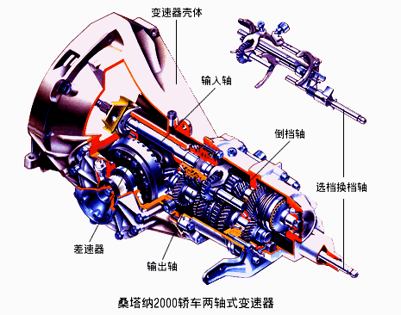
两轴式变速器Twin-shaft transmission
应用：发动机前置前轮驱动，发动机后置后轮驱动的汽车。
Application: FF,RR vehicle.
特点：输入轴（第一轴）与输出轴（第二轴）平行，无中间轴。
Feature: the input axis parallels the output axis and there is no intermediary axis.

Slide 36
两轴式变速器Twin-shaft transmission
动力传递路径：输入轴—— 输入轴齿轮——输出轴齿轮——输出轴。
Power drive path: input axis—— gear of input axis——gear of output axis——output axis
组成：输入轴、输出轴、倒档轴、轴承、变速齿轮
Components: input axis, output axis, back-up axis, bearing, speed changing gear.

Slide 37
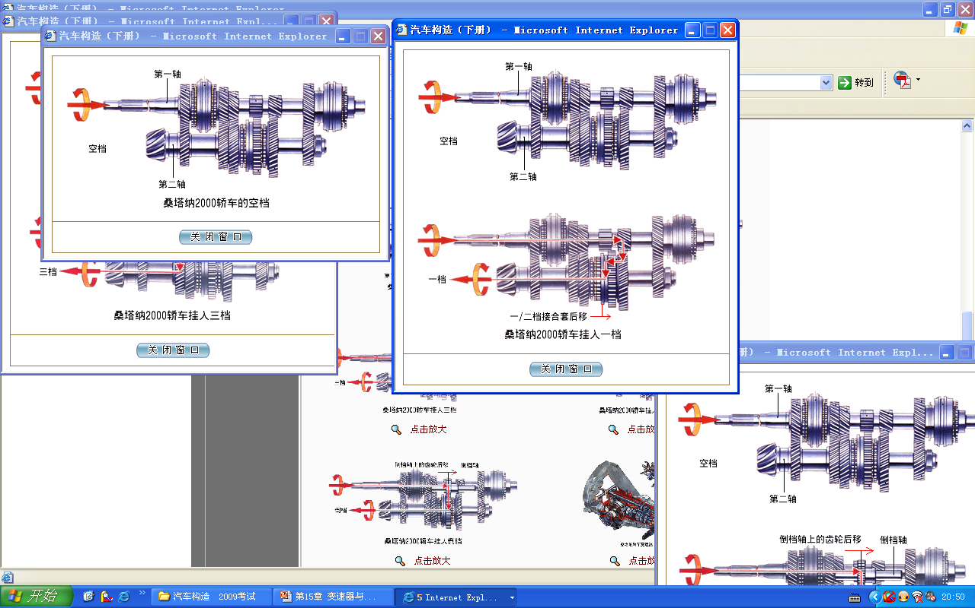
两轴式变速器动力传递路线
Power drive path of twin-shaft transmission

Slide 38
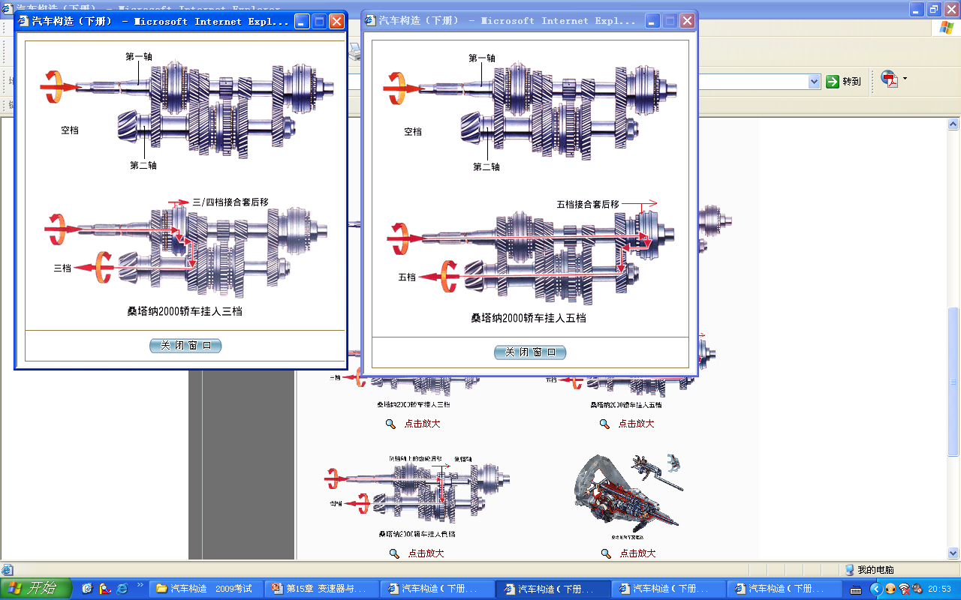
两轴式变速器动力传递路线
Power drive path of twin-shaft transmission

Slide 39
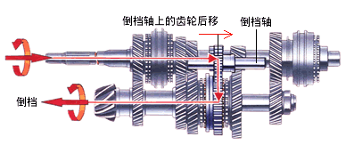
两轴式变速器动力传递路线
Power drive path of twin-shaft transmission

Slide 40
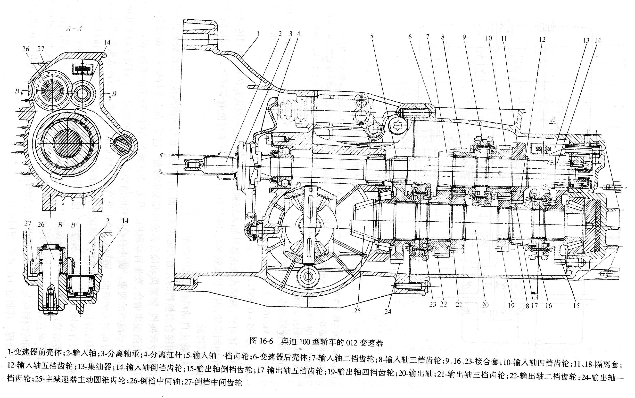
奥迪100型轿车012变速器传动机构结构
Drive mechanism of 012 transmission of Audi 100
发动机纵置
Longitudinal engine

Slide 41
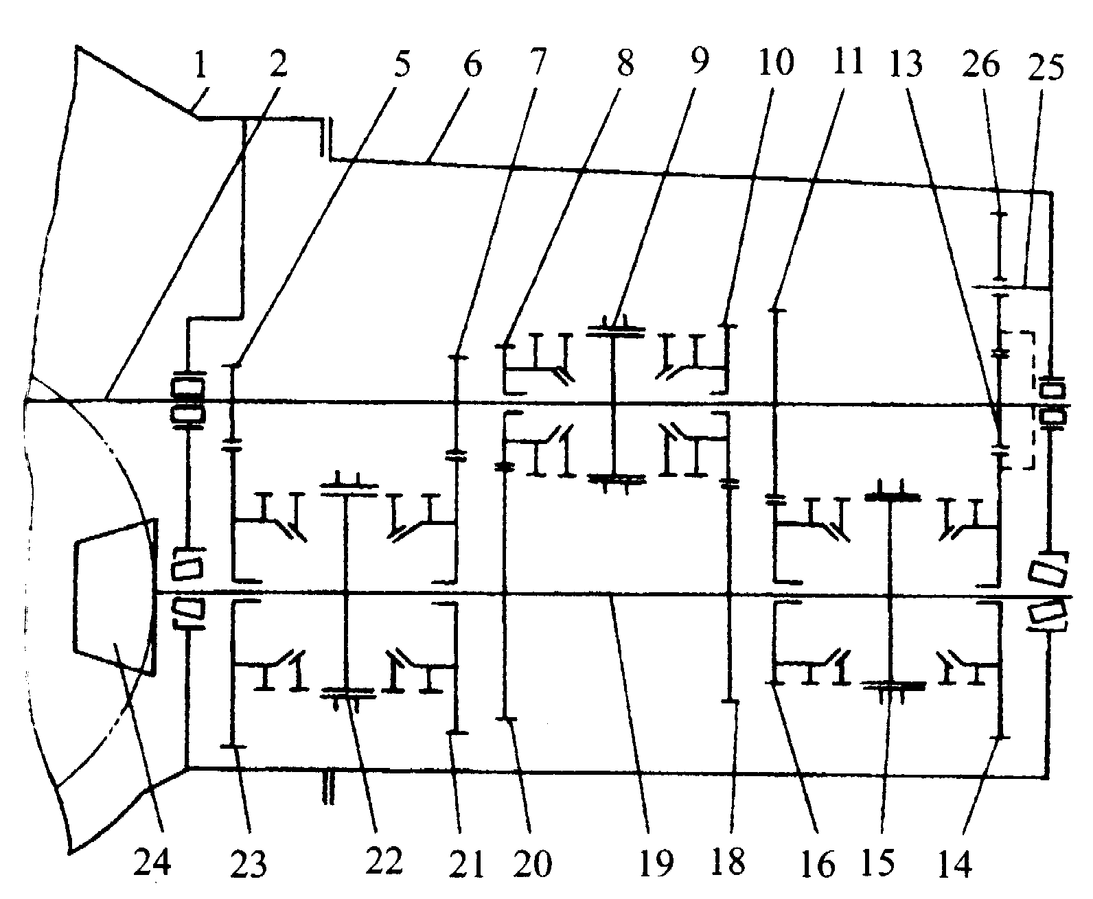
012变速器传动示意图
The transmission schematic diagram of 012 transmission
输入轴
Input shaft
三、四挡接合套
The joint sleeve of third and forth gears
倒挡中间轴
The intermediate shaft of reverse gear
输出轴
Output shaft
一、二挡接合套
The joint sleeve of first and second gears
五、倒挡接合套
The joint sleeve of fifth and sixth gears
思考
空挡和一档传动时，其它齿轮的运动？
How do other gears move when at neutral gear or first gear？

Slide 42
012变速器各挡传动比计算
The calculation of 012 transmission’s each gears
i₁=Z₂₃/Z₅=39/11=3.545
i₂=Z₂₁/Z₇=40/19=2.105
i₃=Z₂₀/Z₈=40/28=1.429
i₄=Z₁₈/Z₁₀=40/19=2.105
i₅=Z₁₆/Z₁₁=31/37=0.838
i_{R}=（Z₂₆/Z₁₃）×（Z₁₄/Z₂₆）=35/10=3.5

Slide 43
两轴变速器特点
The characteristics of twin-shaft transmission
无中间轴，输入轴和输出轴平行；
No intermediate shaft. Input shaft is parallel with output shaft;
没有直接档，因此高速档的效率比三轴变速器低；
No direct gear. So its high gear is less efficient than triaxial transmission;
在传动线路中只有一对齿轮啮合，机械效率高，噪音小；
Only a pair of gears mesh in the transmission line, so the mechanical efficiency is high and the noise is low；
输入轴和输出轴旋转方向相反；
Input shaft and output shaft rotates in opposite directions;
结构简单，紧凑、容易布置；
The structure is simple， compact and easy arrangement ;
在FF或RR布置的汽车上广泛采用，一般将主减速器和差速器也集成在变速箱内，不单独需要离合器壳。
It is widely used in the FF or RR design. Usually the main reducer and differential integrate in the gearbox and needn’t a clutch housing specially.

Slide 44
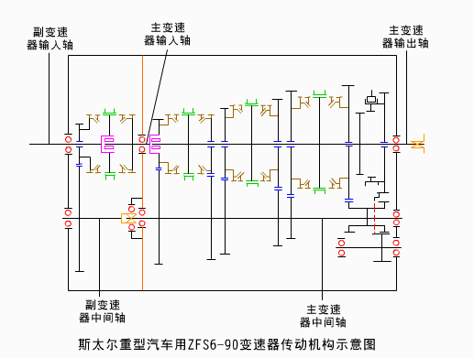
组合式变速器
Combinatory transmission

Slide 45
组合式变速器的功用
The function of combinatory transmission
重型货车的装载质量大，使用条件复杂。欲保证重型车具有良好的动力性、经济性，须有更多的挡位和更大的传动比。
The pay mass of heavy truck is big. And the usage conditions of heavy truck are complex. To ensure the heavy truck have good dynamics and economy, more gears and larger ratio is needed.
为避免变速器的结构过于复杂和利于系列化生产，多采用组合式变速器，即以1—2种四挡或五挡变速器为主体，通过更换齿轮副和配置不同的副变速器(一般为两挡)，得到一组不同挡数不同传动比范围的变速器系列。
To avoid the structure of the transmission is too complex and to benefit series production, combined transmission is used commonly. Namely using one or two kinds of four or five gears transmission as the main part. Through changing gear pair and configuring different auxiliary transmission (usually two gears) to acquire a series of transmission with different gears and different ratio .
组合式变速器传动比：i=i_{主}*i_{副}
The ratio of combinatory transmission ：i=i_{M}*i_{A}

Slide 46
组合式变速器的分类
The classification of combinatory transmission
副变速器有普通齿轮式和行星齿轮式两种；
There are two types of auxiliary transmission, that is ordinary gear type and planetary gear type .
普通齿轮式副变速器结构简单，传力时齿轮的机械负荷较大；
The structure of ordinary gear type auxiliary transmission is simple. The load of gears is larger when transmitting torque;
行星齿轮机构同时啮合的齿数多，能传递较大的转矩。
The total mesh tooth pair number of planetary gear is more and can transmit larger torque.

Slide 47
组合式变速器的结构特点
The structural features of combinatory transmission
副变速器多与主变速器制成一体，它与主变速器的区别是没有倒挡。
Auxiliary transmission install integrally with main transmission usually. The difference with main transmission is no reverse gear.
副变速器传动比较小时多串联在主变速器之前，传动比较大的副变速器多串联在主变速器之后，以利于减小主变速器的质量和尺寸。
Usually, auxiliary transmission series connect before the main transmission when the ratio of it is small, and auxiliary transmission series connect after the main transmission when the ratio of it is big. It benefits reducing the mass and size of main transmission.

Slide 48
防止跳档的结构措施
The structural measure to prevent trip stop
由于接合套与接合齿圈的结合长度短以及经常换档引起接合套的齿端磨损等原因，使汽车在正常行驶时因振动造成接合套与接合齿圈脱离，发生自动跳档。
Because the engagement length of joint sleeve and joint ring gear is short and the wear of joint sleeve’s tooth end caused by shifting frequently, the joint sleeve and joint ring gear will drop out caused by vibration when the vehicle is travelling and result in automatic shifting.
典型的防跳档结构措施
The classical structural measure to prevent trip stop
接合套与结合齿圈的齿端制成倒斜面；
The tooth ends of joint sleeve and joint ring gear are made into inverted angular surface；
花键毂齿端的齿厚切薄；
The thickness of splined hub’s tooth end is cut thin；
接合套齿端形成凸肩。
The tooth tip of joint sleeve is manufactured as shoulder.

Slide 49
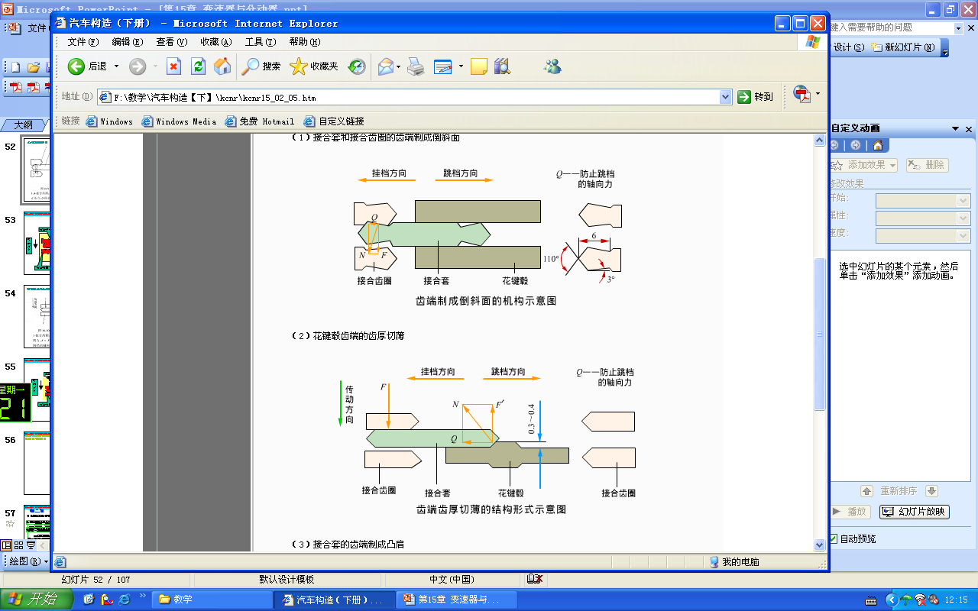
接合套与接合齿圈的齿端制成倒斜面
The tooth ends of joint sleeve and joint ring gear are made into inverted angular surface

Slide 50
花键毂齿端的齿厚切薄
The thickness of splined hub’s tooth end cut thin

Slide 51
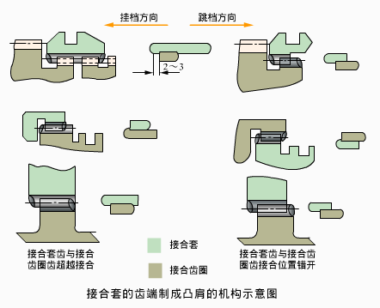
接合套的齿端制成凸肩
The tooth tip of synchronizer manufactured as shoulder

Slide 52
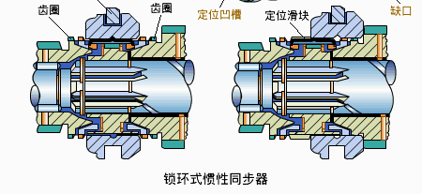
第二节 同步器
Section 2 Synchronizer

Slide 53
同步器的作用
The function of synchronizer
无同步器的普通变速器的操纵复杂，换档过程中容易产生冲击，对驾驶员的熟练程度要求高，容易造成驾驶员的疲劳。
The operation of common transmission without synchronizers is complex. It causes impact easily during shifting. The demand of drivers’ proficiency is high, so it is easy to cause the driver's fatigue.
为克服上述缺点，在普通变速箱上采用同步器，使换档时即将啮合齿轮的接合部位与接合套的速度相等，即实现同步。
In order to overcome the disadvantages above, we install synchronizers in the common transmission to ensure the speed of the meshing gear’s mesh part is the same as the synchronizer’s when shifting. That is to realize synchronization .

Slide 54
同步器的分类
The classification of synchronizer
常压同步器；
Constant pressure synchronizer
惯性式同步器：锁环式、锁销式
Inertial type synchronizer ： Lock ring type, lock pin type
自行增力式同步器。
Self-energizing type synchronizer

Slide 55
惯性式同步器
Inertial type synchronizer
惯性同步器靠摩擦原理工作；
Inertial type synchronizer works relying on friction principle；
在结构上保证了接合部位在未达到同步时不能接触，因此可以避免冲击和发生的噪音；
Structurally, it ensures the joint part can’t contact before reaching synchronization. So it can prevent impact and voice;
广泛应用于轿车和轻型、中型车辆。
Widely used in cars, light vehicles and intermediate size vehicles.

Slide 56
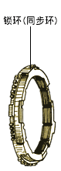
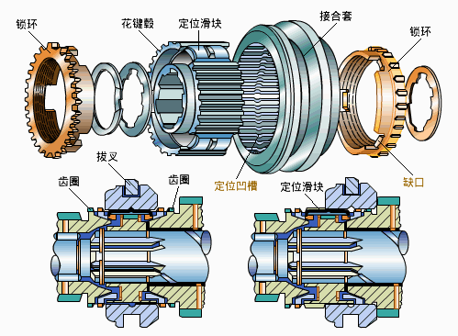
锁环式惯性同步器的结构
The structure of lock ring type inertial synchronizer
同步器花键毂的内花键与轴上的外花健配合，用卡环轴向固定。
The internal spline of synchronizer’s splined hub engages with external splines of the shaft and is axially fixed using snap rings.
同步器接合套的内花键与花键毂的外花键滑动配合，接合套可轴向移动。
The internal spline of synchronizer’s joint sleeve slip fits with the external spline of splined hub, and joint sleeve can move axially.

Slide 57
锁环式惯性同步器的结构
The structure of lock ring type inertial synchronizer
花键毂与齿圈之间有一青铜制成的锁环（同步环），锁环上有断续的短花键齿圈；
There is a lock ring (synchronizing ring) made from bronze between splined hub and ring gear, and there is intermittent short spline gear ring on the lock ring;
花键齿的断面齿廓、尺寸及数量与对应齿圈及花键毂的外花键齿均相同。
The section profile, size and number of spline tooth are the same as corresponding gear ring’s and the tooth of splined hub’s external spline.

Slide 58
锁环式惯性同步器的结构
The structure of lock ring type inertial synchronizer
锁环上的花键齿在对着接合套的一端都有倒角（锁止角），且与接合套齿端的倒角相同。
There are chamfers(lock-up angle) on the spline tooth of lock ring at the side of facing joint sleeve. And the chamfers are equal to the chamfers of joint sleeve’s tooth ends.
三个滑块分别嵌合在花键毂的三个轴向槽内，可沿轴向滑动。
The three sliders are separately nested in the axial grooves of splined hub and can slide axially .

Slide 59
锁环式惯性同步器的结构
The structure of lock ring type inertial synchronizer
锁环具有与齿圈上的锥形面锥度相同的内锥面；
The lock ring has the same inner cone as the taper of cone on the ring gear.
锥面上制出细牙的螺旋槽，以便两锥面接触后能破坏油膜，增加锥面间的摩擦，缩短同步时间。
Fine tooth spiral grooves is manufactured on the cone to damage the oil film after the contact of two cones and increase the friction of two cones to shorten the synchronization time.

Slide 60
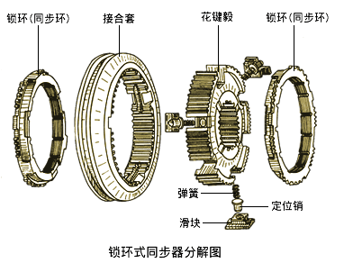
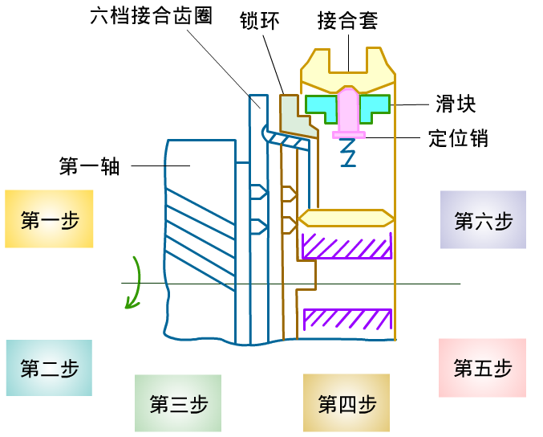
锁环式惯性同步器的结构
The structure of lock ring type inertial synchronizer
三个定位销分别插入三个滑块的通孔中，在弹簧的作用下，定位销压向结合套，使定位销端部的球面正好嵌在接合套中部的凹槽中，起到空挡定位的作用。
Three locating pin insert through-holes of three slider separately. Under the force of spring, locating pin press to joint sleeve and make the sphere of locating pin’s end embed the groove of joint sleeve’s middle part. It can play the role of neutral gear positioning.
滑块两端伸入锁环的三个缺口中。
The two ends of slider stretch into the tree gap of lock ring.

Slide 61
锁环式惯性同步器的结构
The structure of lock ring type inertial synchronizer
锁环的三个凸起部分别伸入花键毂的三个通槽中；
The three lug bosses of lock ring stretch into the three through grooves of splined hub separately；
只有当凸起部位于通槽的中央时，接合套与锁环的齿方能结合;
Only at the time when the lug bosses are located in the centre of through grooves can the teeth of joint sleeve and lock ring mesh.
通槽宽度为锁环凸起部宽度加上接合套的一个齿厚。
The width of through groove equals the width of lug bosses of lock ring adding up with the tooth thickness of joint sleeve.

Slide 62
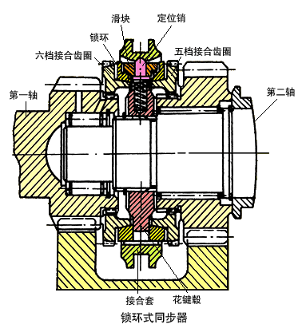
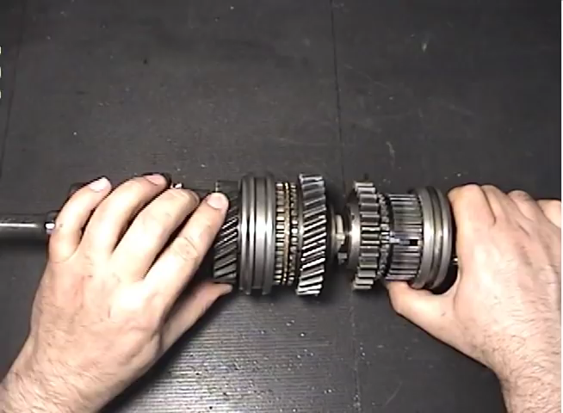
锁环式惯性同步器的结构
The structure of lock ring type inertial synchronizer
组成：花键毂、接合套、锁环、滑块、定位销、弹簧等。
Component：spline hub, joint sleeve, lock ring, slider, locating pin, spring and so on.

Slide 63
锁环式惯性同步器的工作原理
The working principle of lock ring type inertial synchronizer
假定以低速挡换入高速挡；
Assuming shifting from low gear to high gear ；
当从低速挡退到空挡时,n₄=n₇,n₃>n₇即,n₃>n₄。
When returning low gear to neutral gear, n₄=n₇,n₃>n₇ that is:n₃>n₄ .

Slide 64
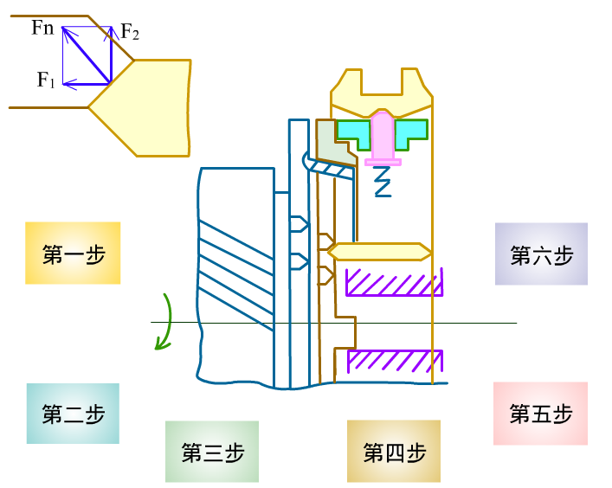
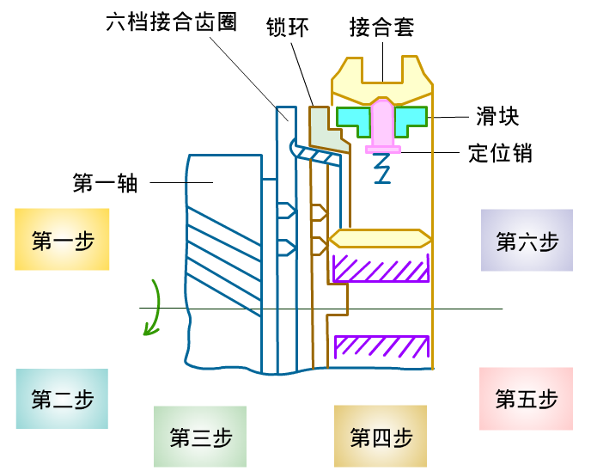
锁环式惯性同步器的工作原理
The working principle of lock ring type inertial synchronizer
接合套左移，定位销带动滑块左移；
Joint sleeve moves left, and the locating pin drives the slider moves left;
滑块推动锁环移向齿圈，产生摩擦；
The slider pushes the lock ring move to the ring gear and arouse friction.
锁环相对接合套超前一个角度；Lock ring is an angle ahead of joint sleeve；
接合套齿与锁环齿错开半个齿厚；The tooth of joint sleeve and the tooth of lock ring stagger half of tooth thickness;
接合套齿端倒角与锁环齿端倒角相互抵触；The tooth end chamfer and lock ring chamfer are collision with each other.
两齿端产生相互作用力。Generating interaction force between the two tooth end.

Slide 65
锁环式惯性同步器的工作原理
The working principle of lock ring type inertial synchronizer
齿圈作减速旋转，产生与旋转方向相同的惯性力矩M₁，并通过摩擦锥面作用到锁环上，阻止锁环相对接合套向后旋转。
The ring gear decelerates and produces a inertia torque M₁, which has the same direction as rotation direction. The torque effects on the lock ring through the friction cone and prevents the lock ring rotates backward relative to joint sleeve.
如果M₂>M₁，锁环可相对接合套向后退转，进入结合；
If M₂>M₁,the lock ring can rotates backward relative to joint sleeve, then meshes;
如果M₂<M₁，则二者不可能结合。
If M₂<M₁，the two can’t mesh.

Slide 66
锁环式惯性同步器的工作原理
The working principle of lock ring type inertial synchronizer
惯性力矩M₁与轴向力F₁的垂直于摩擦锥面的分力成正比，而拔环力矩则与切向力F₂成正比。
Inertia torque M₁ is proportional to the component force perpendicular to the friction cone of axial force F₁.And the pull ring torque is proportional to tangential force F₂.
切向力F₂所形成的力矩试图使锁环相对于接合套向后退转，称为拔环力矩M₂；The torque formed by tangential force F₂ tries to make the lock ring rotate backward relative to joint sleeve. It is called pull ring torque M₂ ;
轴向力F₁使锁环和齿圈锥面相互压紧，使两者转速迅速接近。The axial force F₁ makes the lock ring compress the cone of ring gear tightly and the speeds of the two approach fast.

Slide 67
锁环式惯性同步器的工作原理
The working principle of lock ring type inertial synchronizer
在设计同步器时，适当选择锁止角和摩擦锥面的锥角，便能保证在达到同步之前，齿圈施加在锁环上的惯性力矩M₁总大于切向力F₂形成的拔环力矩M₂。When designing the synchronizer, appropriately choosing the lock-up angle and the cone of friction’s taper angle, we can ensure that the inertia moment M₁ that ring gear imposing on lock ring is bigger than the pull ring torque M₂ caused by tangential force F₂ before synchronizing.
F₁ 和F₂都是法相力F_{N}的分力，二者的比值取决于花键齿锁止角的大小。F₁ and F2 are the component forces of normal force F_{N} ,the ratio of the two depends on the lockup angle of spline tooth.
锁环对接合套的锁止作用是齿圈的惯性力矩造成的。The lock function lock ring to joint sleeve is caused by the inertia moment of ring gear.
惯性式同步器的由来The origin of inertial type of synchronizer

Slide 68
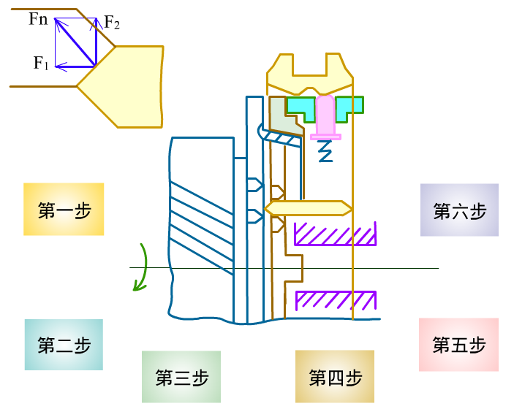
锁环式惯性同步器的工作原理
The working principle of lock ring type inertial synchronizer
接合套继续左移；The joint sleeve continues to move left ;
齿圈与锁环转速相等，惯性力矩消失；The speed of ring gear is equal to lock ring’s. The inertia moment disappears;
拔环力矩M₂使齿圈相对结合套向后退转；Pull ring torque M2 makes the ring gear rotates backward relative to joint sleeve.
接合套进一步左移，锁环的花键齿圈进入结合，锁止作用消失；The joint sleeve moves left further. The splined ring gear of lock ring meshes and the lock-up function disappears.

Slide 69
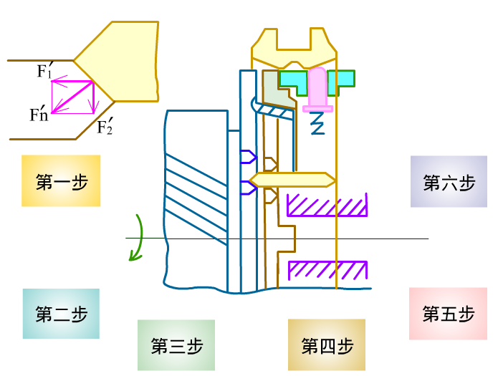
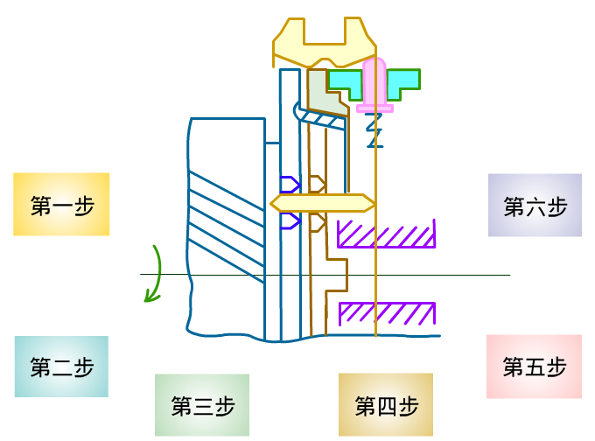
锁环式惯性同步器的工作原理
The working principle of lock ring type inertial synchronizer
接合套继续左移；The joint sleeve continues to move left;
接合套花键齿与齿圈花键齿抵触；The spline tooth of joint sleeve collides with spline tooth of ring gear.
作用在齿圈花键齿端斜面上的切向分力使齿圈相对于锁环及接合套转过一个角度；The tangential component force effecting on the slope of the tooth end of ring gear’s spline makes the ring gear rotate an angle relative to lock ring and joint sleeve.
接合套与齿圈结合，完成换挡。The joint sleeve meshes with the ring gear. Shifting completes.

Slide 70
锁环式惯性同步器的特点
Lock ring synchronizer’s feature
结构紧凑； Compact structure;
径向尺寸小； Radial diameter is small;
锥面间产生摩擦力不大；
Friction between cones is not great;
结合齿端面作为锁止面，容易磨损而失效
Clutch teeth’s end face acts as locking surface, and it is easy to wear and leads to failure;
适用于转矩不大的高速档或者轿车和轻型车辆。
Applied on top gear whose torque is not high or passenger car and light vehicle.

Slide 71
两种惯性式同步器的比较
Comparison between lock ring and lock pin synchronizer
锁环式惯性同步器:结构紧凑，但径向尺寸小、锥面间摩擦力矩较小，所以多用于传递转矩不大的轿车和轻型货车的变速器；Lock ring synchronizer : structure is compact but radial dimension is small, friction moment between cones is also small, usually applied on passenger car and light truck’s transmission that deliver small torque.
锁销式惯性同步器:在结构上允许采用直径较大的摩擦锥面，摩擦锥面间可产生较大的摩擦力矩，缩短了同步时间，多用在中型和重型汽车上。Lock pin synchronizer :large diameter friction cone is allowed in structure, large friction moment could be produced between friction cones so that synchronizing time is decreased , and it is often applied on medium and heavy trucks.

Slide 72
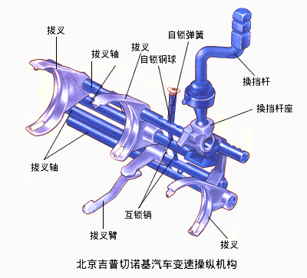
第三节 变速器的操纵机构
Part 3 Transmission operation mechanism

Slide 73
变速器操纵机构的功用和类型
Function and types of control mechanism
功用：让驾驶员根据路面情况能准确地将变速器挂上或者摘下所需要的某个档位，以保证汽车安全行驶。Function: ensure that driver engage or disengage the gear according to road condition and guarantee the vehicle safety travel.
分类 Classification
直接操纵机构
Direct control mechanism
远距离操纵
Indirect control mechanism

Slide 74
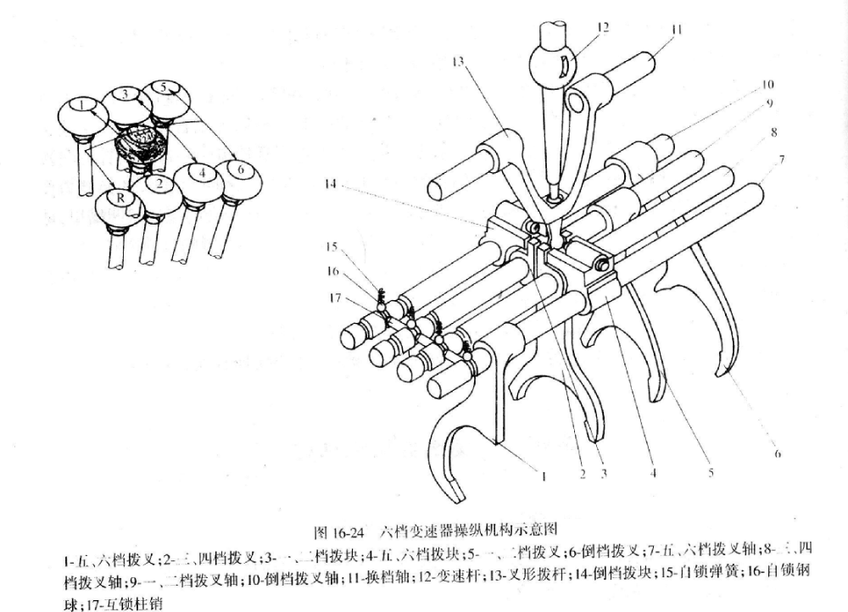
直接操纵机构
Direct control mechanism
变速器布置在驾驶员座位附近，变速杆由驾驶室地板伸出，驾驶员可以直接操纵换档。Transmission is close to driver’s seat and shift lever extends out from floor board and the driver can shift gear directly.
组成：变速杆、叉型拨杆、拨块、拨叉、拨叉轴、安全装置。Composition: Gear-shift lever, fork shift lever, shift block, selector rod and safety device.
安装位置：安装在变速器的上盖或者侧盖内；Mounting position: upper cover or side cover of transmission
特点：结构紧凑、简单、操纵方便。Feature : structure is compact and simple and easy to handle.

Slide 75
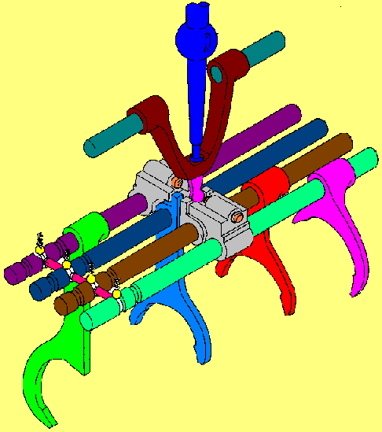
直接操纵式变速器操纵机构的构造
Control mechanism structure of direct control type transmission
叉形拨杆Fork shift lever
变速杆
Gear shift lever
五、六档拨叉轴
Fifth-sixth selector rod
换档轴Shift shaft
五、六档拨块Fifth-sixth shift block
一、二档拨叉轴
First-second selector rod
自锁钢球
Self-blocking Steel ball
倒档拨叉轴
Reverse selector rod
互锁销
Interlock pin
倒档拨叉
Reverse shift fork
五、六档拨叉
Fifth-sixth shift fork
三、四档拨叉
Third-fourth shift fork
一、二档拨叉
First-second shift fork

Slide 76
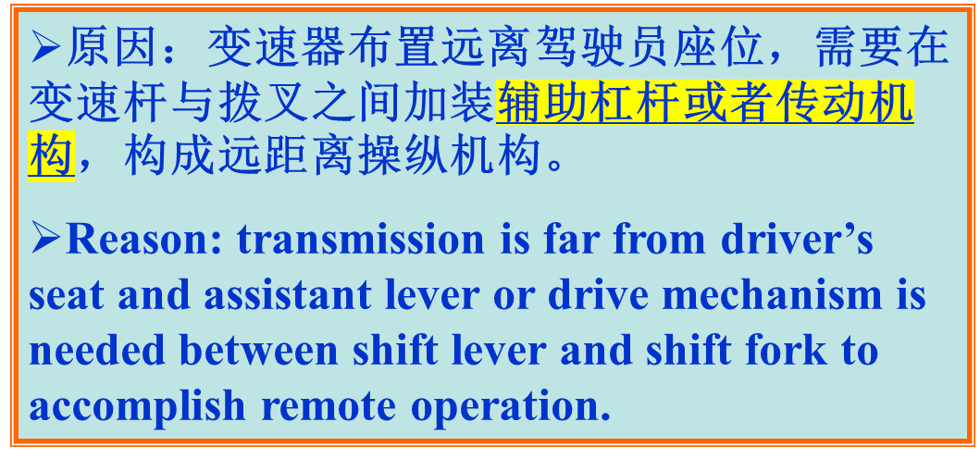
间接操纵式变速器操纵机构
Control mechanism of indirect control type transmission
组成：外部操纵机构和内部操纵机构。
Composition: internal and external operation mechanism.

Slide 77
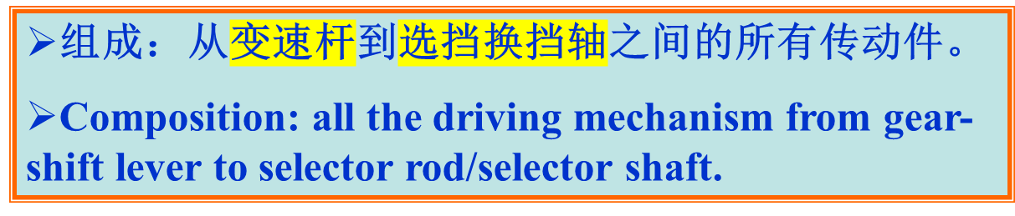
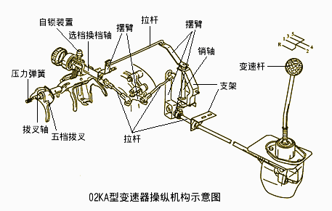
外部操纵机构
External operation mechanism

Slide 78
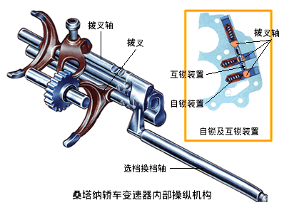
内部操纵机构
Internal operation mechanism
组成：选挡换挡轴、拔叉轴、拔叉、自锁装置、互锁装置、倒挡锁等。Composition: gear shift lever, shift fork, interlocking device, self-locking device, reverse latch.

Slide 79
操纵机构的安全装置
Safety device of operation mechanism
变速器的操纵装置应满足
Operation mechanism should guarantee:
保证变速器不自行脱挡或挂档；Transmission won’t shift gear or get out of gear by itself.
保证变速器不同时挂入两挡；Transmission won’t shift into two gears at the same time.
防止误挂倒档。Prevent shifting into reverse gear.
自锁装置
Self-locking device
互锁装置 Interlocking device
倒挡锁装置Reverse gear lock device

Slide 80

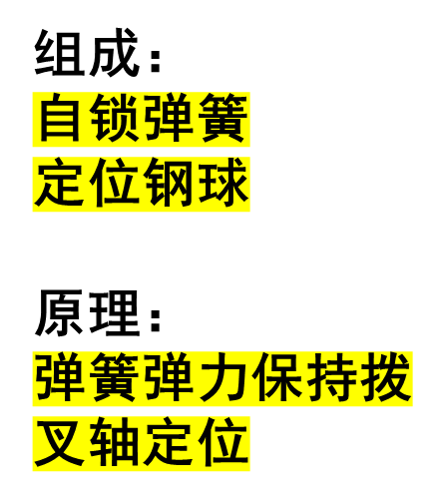
自锁装置组成及工作原理
Structure and principle of self-locking device
自锁弹簧
Self-locking spring
自锁钢球
Self-locking ball
拨叉轴
Shift shaft

Slide 81
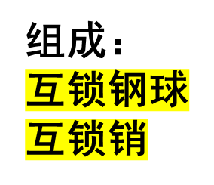
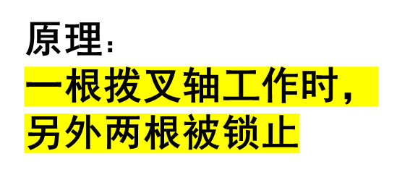
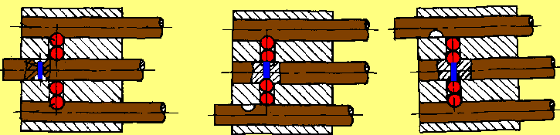
互锁装置组成及工作原理
Structure and principle of interlocking device
空档状态
Neutral state
拨叉轴
Shift fork shaft
互锁销
Interlocking pin
互锁钢球 Interlocking ball

Slide 82
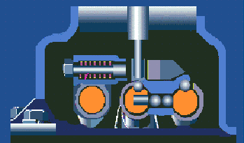
倒挡锁装置组成及工作原理
Structure and principle of reverse latch
倒档拨块
Reverse block
倒档锁弹簧
Reverse latch spring
倒档锁销
Reverse latch pin
驾驶员在换倒档时要克服倒档锁弹簧弹力，变大的换档阻力，可提醒驾驶员。Driver has to overcome slightly great force of spring to shift reverse gear which would give driver a warning.

Slide 83
挡位说明
Introductions on shifting gears
每一根拨叉轴最多实现2个档位，档位越多换档操纵机构越复杂。
Each gear shift shaft can realize two gears at most, and the more gear stages are, the more complex operation mechanism is.
对于不同的变速箱，其档位排列不同，因此在仪表板上或者操纵手柄上应该有变速箱档位排列图。
Shifting arrangement of different transmission is different so shifting arrangement graph should be shown on instrument panel or control handle.

Slide 84
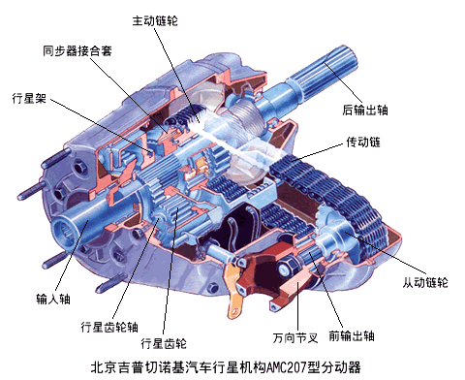
第四节 分动器
Part 4 Transfer case
功用：在多轴汽车上采用分动器，将变速器的输出动力分配到各驱动桥。因此分动器一般具有一个输入轴、多个输出轴。
Function: transfer case is applied on multi-axle vehicle to distribute power of transmission to each driving axle, so transfer case usually has one input shaft and several output shafts.

Slide 85
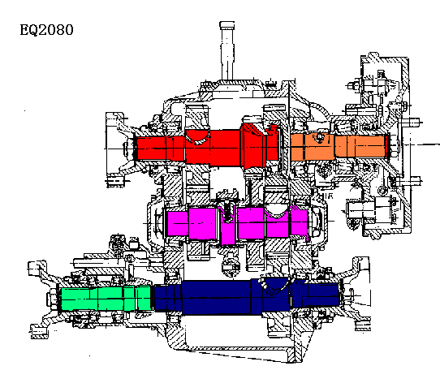
分动器结构 Transfer case structure
分动器基本结构为一齿轮传动系统；Basic structure: gear transmission system.
输入轴直接或通过万向传动装置与变速器第二轴相连；Input shaft links with second shaft of transmission directly or by universal joint.
输出轴有若干个，分别经万向传动装置与各驱动桥连接。There are several output shaft and they link corresponding driving axles by universal joint.
后桥输出轴
Output shaft of rear axle
输入轴 Input shaft
中间轴
Intermediate shaft
中桥输出轴
Output shaft of intermediate shaft
前桥输出轴
Output shaft of front axle

Slide 86
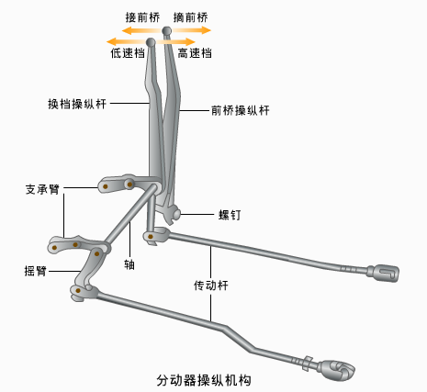
分动器操纵机构
Operation mechanism of transfer case
当分动器挂入低速挡时,其输出转矩较大.为避免中后桥超载,此时前桥必须参加驱动,以分担一部分载荷。When transfer case is shifted into low gear, output torque is very large and front axle must operate to bear a part load to prevent intermediate and rear axles overloading.
分动器操纵原则
Transfer case working principle
非先接上前桥，不得换入低档；Low gear can’t be shifted in lonely before front axle is connected,
非先退出低档，不得摘下前桥。Lower gear can’t be shifted out lonely before front axle is disconnected.
措施：从结构上保证。Method :guaranteed in structure.

Slide 87
本章学习重点
Important points of this chapter
变速器的功用；Transmission function;
能根据变速器传动示意图分析各挡传动路线并计算传动比；Have the ability to analyze transmission route and calculate transmission ratio according to driving diagram.
防止自动跳挡的结构措施；Measures by structure to prevent gear disengaging.
惯性式同步器的结构及工作原理；Structure and principle of inertial synchronizer ;
了解为什么要设置变速器操纵机构安全装置；Understand the reason of setting safety device for transmission operation mechanism.
分动器操纵原则。Operation principle of transfer case.

Slide 88
作业 Assignments
在普通变速器中，第二轴的前端为什么采用滚针轴承？为了润滑滚针轴承，在结构上都采取了哪些措施？
Why needle bearing is applied in second shaft’s fore-end of transmission? And what measures are adopted in structure to lubricate needle bearing?
在变速器的同步器中，常把结合齿圈与常啮合齿轮制成两体（通过花键连接），这是为什么？结合齿圈把由常啮合齿轮传来的转矩传给接合套，但结合齿圈的齿宽较小而常啮合齿轮的齿宽却较大，这是什么道理？
Joint ring gear couples together with constant mesh gear(by spline) in transmission synchronizer ,this is why ? Joint ring gear transfers the torque from constant mesh gear to clutch sleeve ,but the width of joint ring gear is smaller than constant mesh gear, indicate the reason.
简述两轴、三轴普通变速箱的特点。
Indicate the feature of twin-shaft (or tri-shaft) transmission.
在三轴普通变速箱中倒档是如何实现的。
How is reverse gear realized in tri-shaft transmission.
简述防止跳档的几种措施。
Indicate several measures to prevent transmission walking out of mesh.
说明不采用同步器换档的缺点；
Indicate disadvantages of using no synchronizer.

Slide 89
作业 Assignments
同步器有几种，惯性同步器优点。
Synchronizer type and inertial synchronizer’s advantages.
结合某一传动机构示意图计算变速箱各档的传动比。
Compute transmission ratios of every gear stage according to a transmission diagram.
为什么锁环式惯性同步器的在未达到同步时不能结合？
Why can not block synchronizer get joint until joint ring gear and clutch sleeve rotating at the same speed?
变速器操纵机构的有哪些主要部分组成？
Indicate components of transmission control mechanism.
变速器操纵机构的安全装置有哪些？为什么要设置这些安全装置？
Indicate safety device of transmission control mechanism and the reason of setting it
分动器的作用是什么？在低速档转矩输出较大的车辆中。对分动器的操纵有什么样的要求，为什么？
What is the effect of transfer? and what are the handling requirements for transfer on vehicles running in low gear and why ?

